Slide 1
“Walk & Talk” Digital Transformation through Standardisation: IoT and Edge
Report on Landscape of Edge Computing Standards
Orfeas Voutyras – ovoutyras@mail.ntua.gr
StandICT.eu TWG IIoT and Edge member
National Technical University of Athens

Slide 2
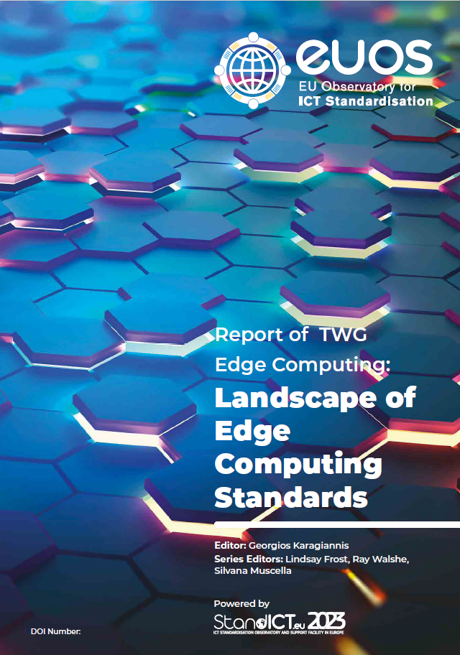
Landscape of Edge Computing Standards Report
252 Standardisation Artifacts studied

Slide 3
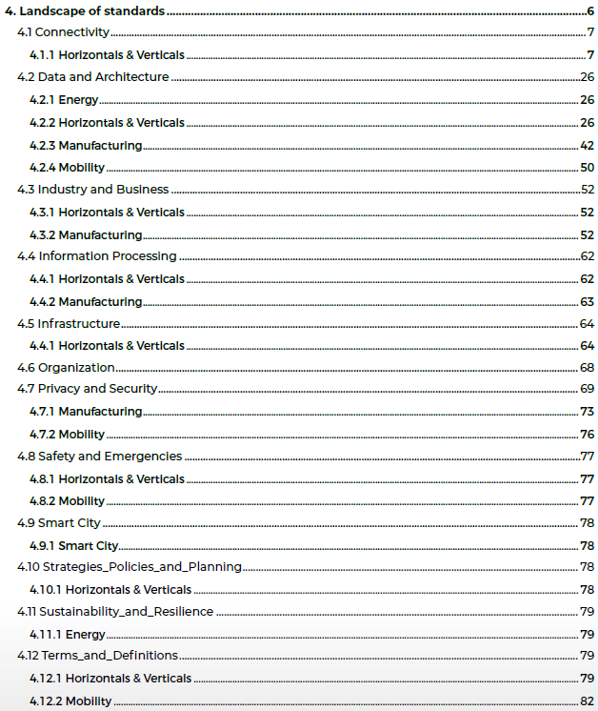
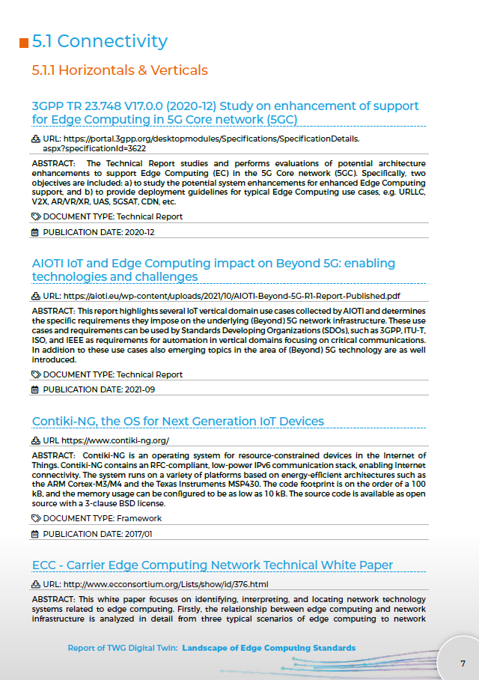
Landscape of Edge Computing Standards Report
252 Standardisation Artifacts studied
For each one:
Domain
Use Case
Source
Title
Abstract
URL
Type
Date

Slide 4
Edge Computing Landscape: SDOs and Alliances
Manufacturing/ Industry Automation
Home/
Building
Vehicular/
Transportation
Farming/
Agrifood
Healthcare
Energy
Cities
Wearables
Horizontal/Telecommunication
*Source: AIOTI WG Standardisation - Edge Computing Release 1.0

Slide 5
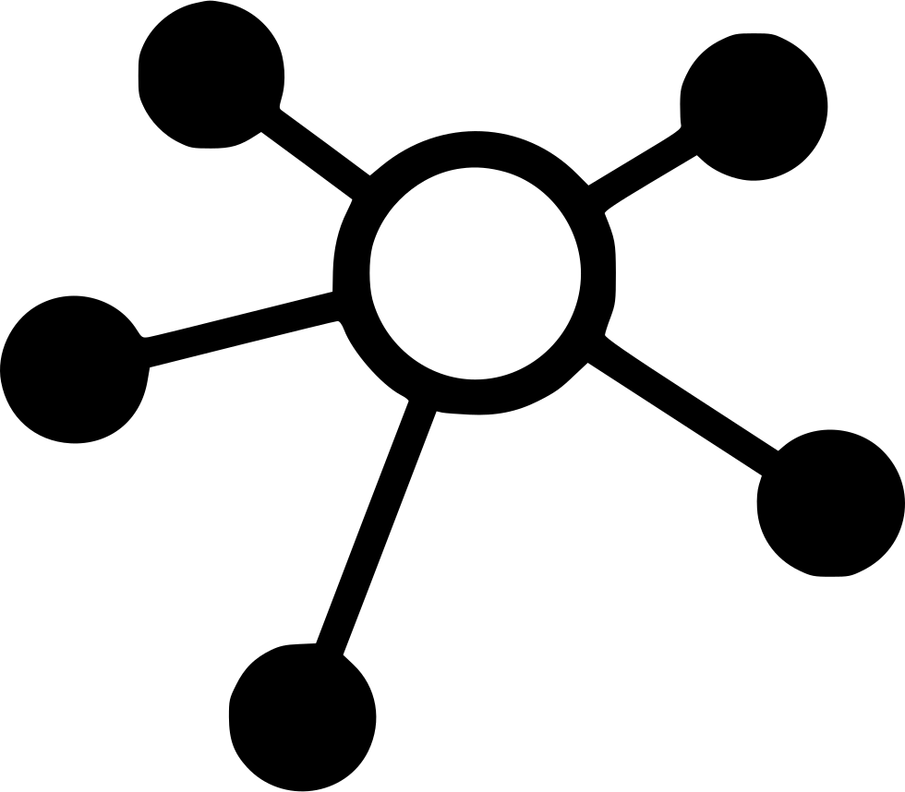
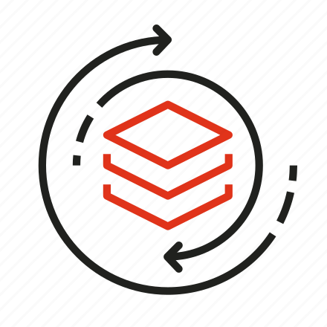
Edge Computing Landscape: Classification
Domains
Use Cases
Terms & Definitions
Data & Architecture
Food & Agriculture
Manufacturing
Infrastructure
Privacy & Security
Energy
Mobility
Wellbeing
Case Studies & Rankings
Health
Environment
Horizontals & Verticals
Connectivity
Strategies & Policies
Water
Home
Sustainability & Resilience
Smart Cities
Building
Education
Information Processing
Industry & Business

Slide 6
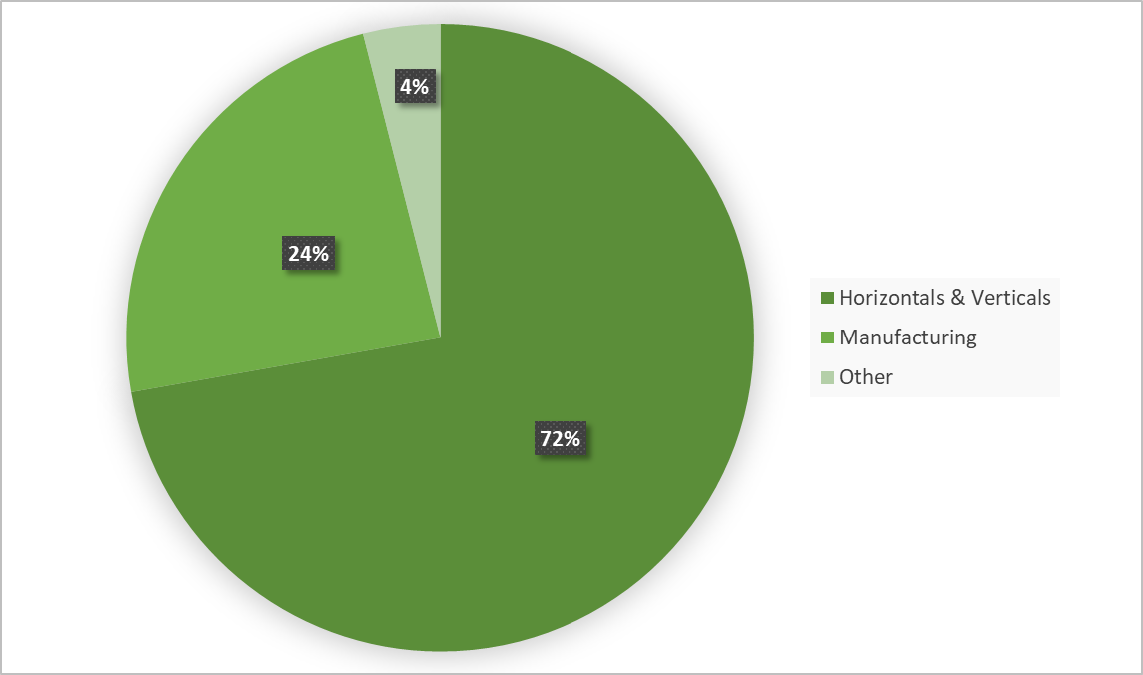
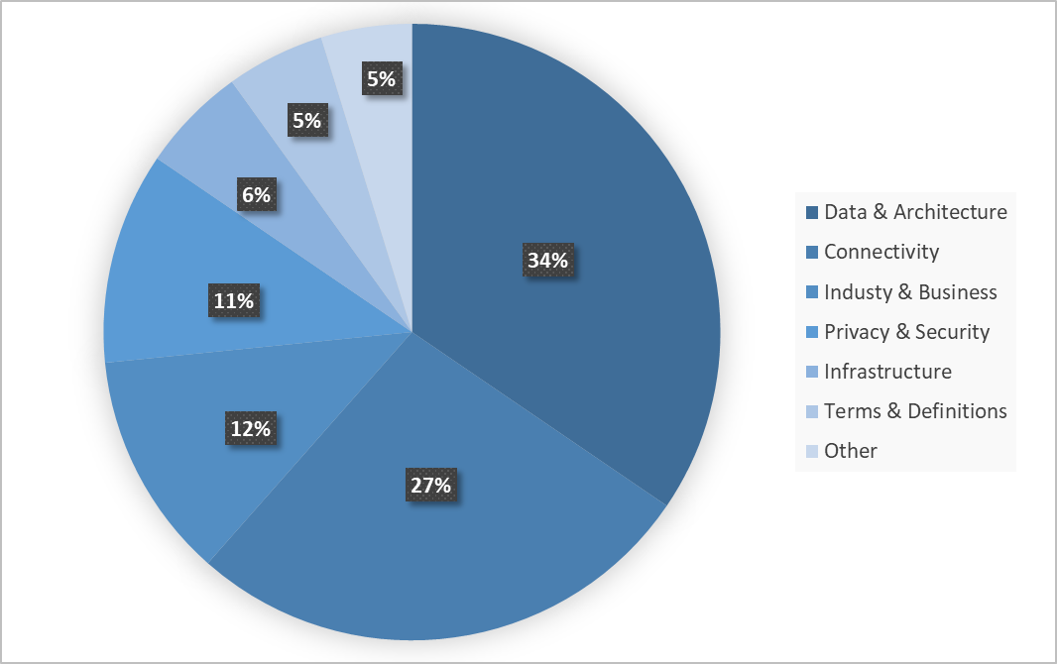
Standardisation artifacts by Use Case & Domain
Artifacts by Use Case
Artifacts by Domain
Most artifacts cover several categories (are not use-case specific).
Most artifacts are focused on Data & Architecture and Connectivity.

Slide 7
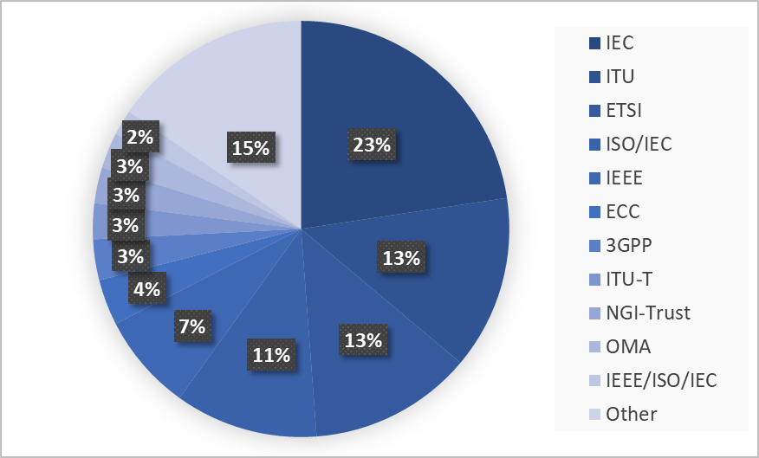
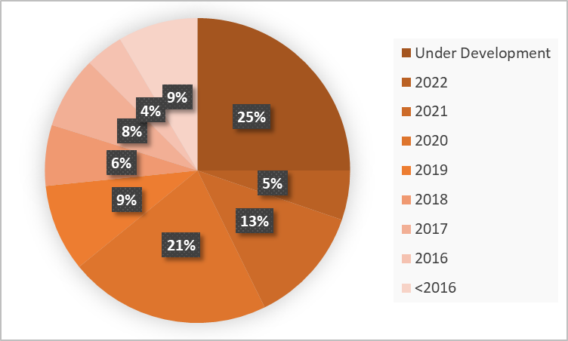
Standardisation artifacts by Source & Year
Artifacts by Source
Artifacts by Year
Most artifacts from international SDOs, with some exceptions.
>50% of artifacts from the past 3 years.

Slide 8
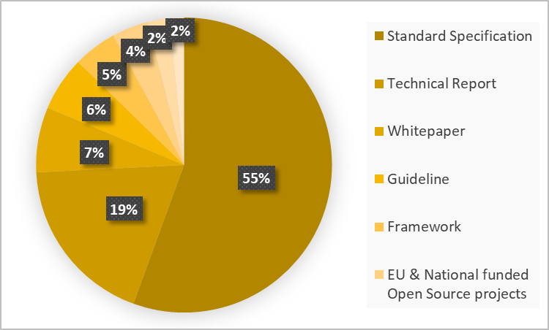
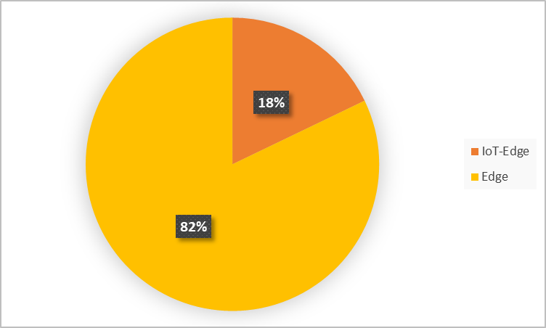
Standardisation artifacts by Type
Artifacts by Type
IoT-Edge vs Edge artifacts overlap
>70% of artifacts covers Standard Specifications and Technical Reports.
Slight overlap between IoT and Edge standardisation artifacts.

Slide 9
Summary and Work to be done
252 standardisation artifacts identified.
More to be added in future versions.
Most of them can be applied to several horizontals & verticals, and focus on several domains.
All items were given only one label.
Further and more complex classification can provide further insights.
Gaps analysis could be helped by such classification.
For now, a quantitative approach is followed.
More ways to identify the coverage of an artifact could be identified.
Most of them are coming from international SDOs.
Attempting to monitor the initiatives from less “traditional” sources (e.g., NGI projects) is challenging but interesting.
Most of them are from the past 5 years.
Temporal analysis per use case and domain could provide insights about the steps taken so far and the upcoming ones.

