Slide 1
Report of TWG Digital Product Passport: Landscape of DPP Standards
28.04.2023 Dr. Jens Gayko / Benjamin Helfritz

Slide 2
Timeline for DPP Regulation and Standardization
Regulation
EC
ESPR proposal
Commenting and trilogue negotiation
Adoption of ESPR
Adoption of DPP for first products

Slide 3
Timeline for DPP Regulation and Standardization
Regulation
EC
ESPR proposal
Commenting and trilogue negotiation
Adoption of ESPR
Adoption of DPP for first products
Standardi-sation
Standardisation request on DPP and standardisation work

Slide 4
Timeline for DPP Regulation and Standardization
Regulation
EC
ESPR proposal
Commenting and trilogue negotiation
Adoption of ESPR
Adoption of DPP for first products
Standardi-sation
Standardisation request on DPP and standardisation work
StandICT.eu TWG DPP
DPP land-scaping report
StandICT.eu

Slide 5
Timeline for DPP Regulation and Standardization
Regulation
EC
ESPR proposal
Commenting and trilogue negotiation
Adoption of ESPR
Adoption of DPP for first products
Standardi-sation
Standardisation request on DPP and standardisation work
StandICT.eu TWG DPP
DPP land-scaping report
StandICT.eu
CIRPASS

Slide 6
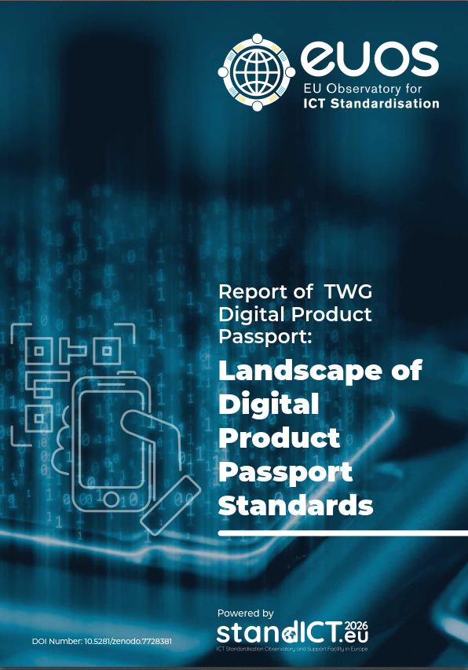
Report of TWG Digital Product Passport: Landscape of DPP Standards
The Technical Working Group DPP
Timeframe: Sep. 2022 – Mar. 2023
The team: Ray Walshe, Director EUOS; Jens Gayko (editor), Benjamin Helfritz (editor), Sharon Farell, Susanne Guth-Orlowski, Maria Rossetti, Rainer Schrundner, Francesca Poggiali, Thomas Roedding, Gerhard Heemskerk, Staffan Olsson, Jamie Clark
EC support: Thomas Reibe, Michele Galatola, Maja Miceli and Ilias Iakovidis
The report

Slide 7
Report of TWG Digital Product Passport: Landscape of DPP Standards
The Technical Working Group DPP
The report
Foreword
Introduction – describing 7 areas of standardisation for DPP
Data carriers
Unique identifiers and their verification
Link between physical product and digital representation, look-up mechanism
Access rights management
Interoperability, including data exchange protocols and formats and data processing
Data storage
Data authentication, reliability, integrity, security and privacy
Landscape of Standards
186 international and European standards from recognized standardization bodies according to EC 1025/2012 directive
Further 78 standards from other standards developing organizations.
First assessment of the relevance of the standards according to the 7 areas described

