Slide 1



StandICT.eu 2023
“Walk & Talk” Webinar on IoT and Edge Computing
13^{h} December 2022 – 10:30 CET
Silvana Muscella
Trust-IT CEO & Coordinator of StandICT.eu 2023

Slide 2
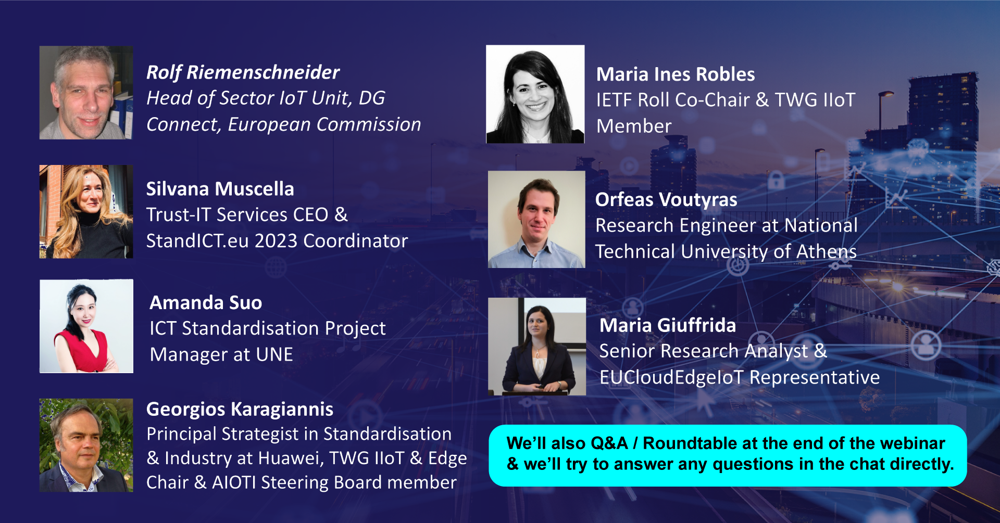
Our Speakers

Slide 3
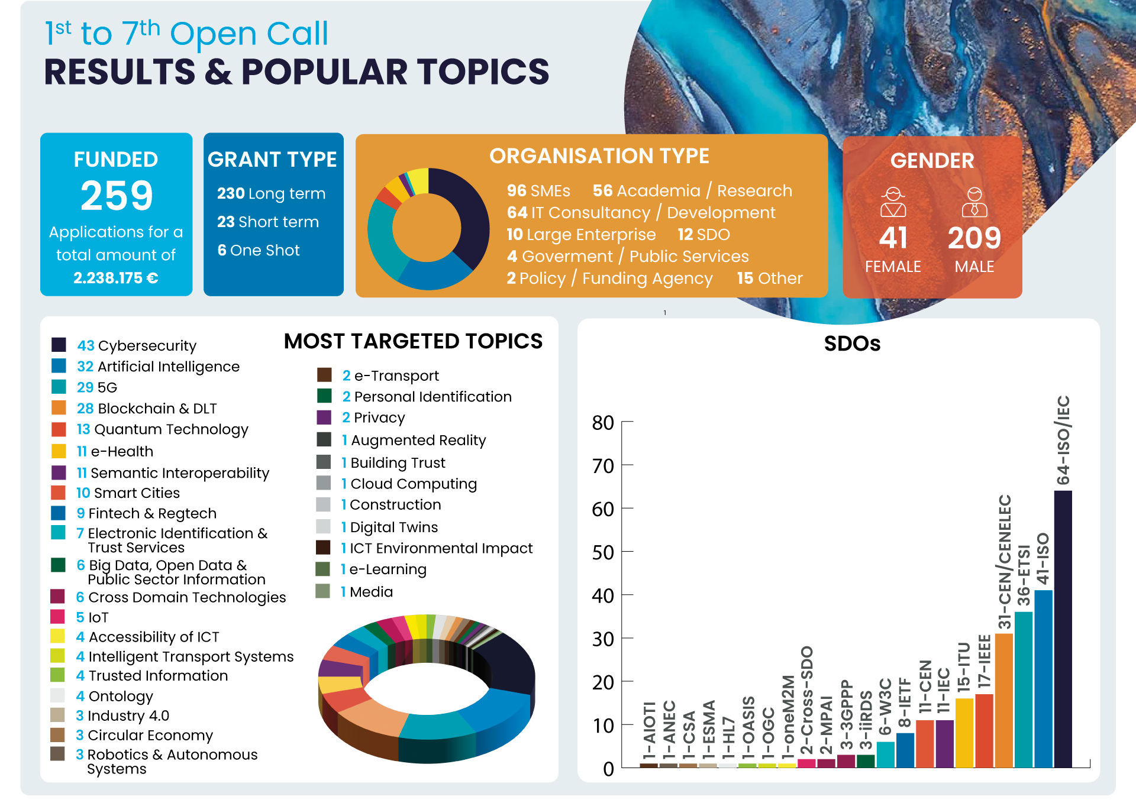
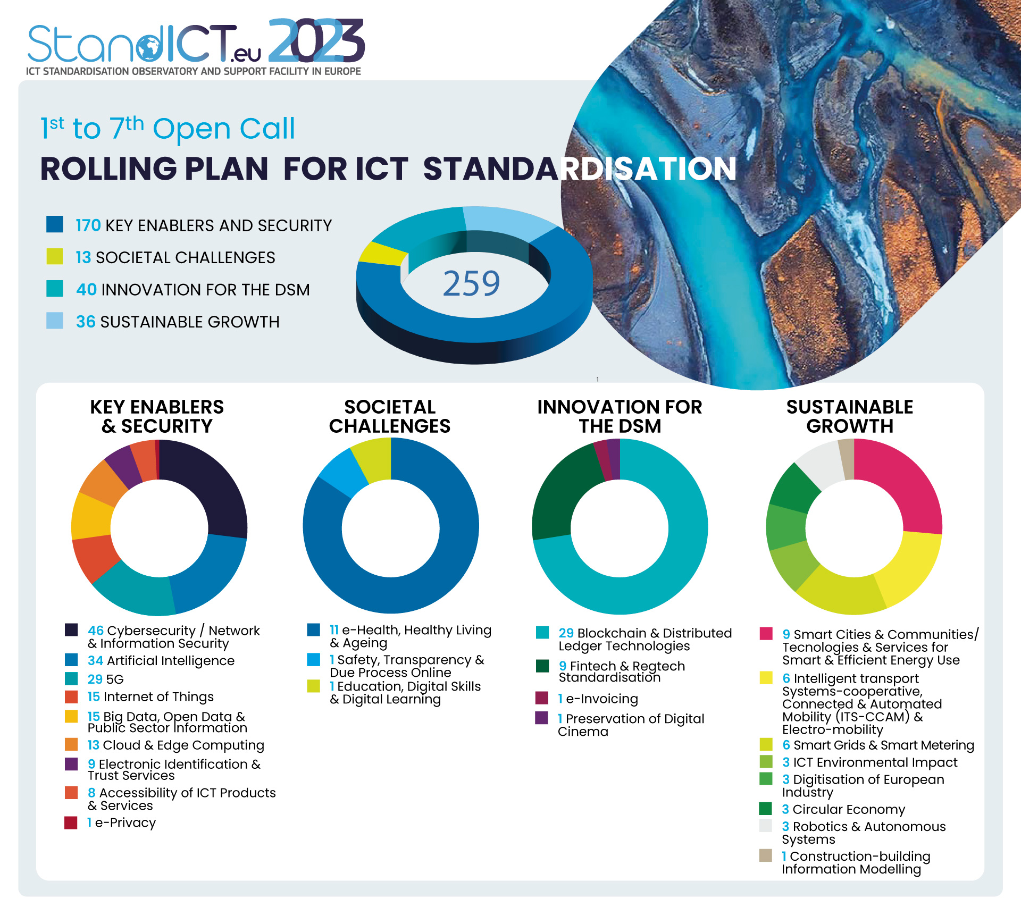
Snapshot on Open Calls, Major Accomplishments & connection with the MSP Rolling Plan for ICT Standardisation
Overview of where funding has been awarded
How the overall funded activities fit in to the MSP Rolling Plan for ICT Standardisation
Total of 15 proposals submitted on IoT of which have been 5 funded

Slide 4

09th StandICT.eu 2023 Open Call (LAST CHANCE!)
📣 Working in ICT Standards & need financial support to carry forward your activity?
Launch date – 15th December 2022
Deadline to submit applications: 📅 15th February 2023 – 5pm (CET)
Maximum Grant available up to 10.000 Euro

Slide 5



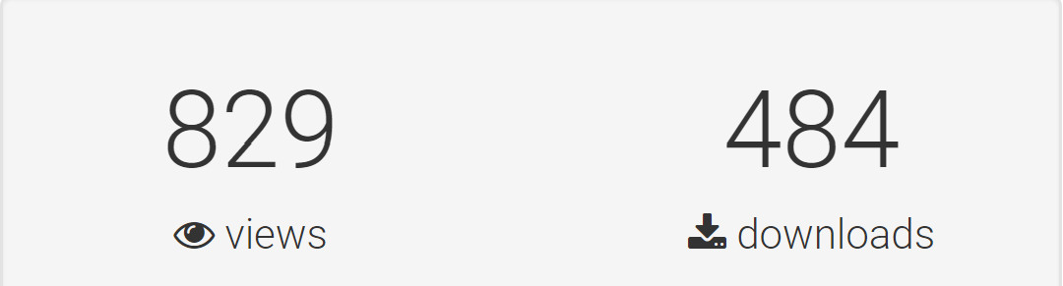
EUOS TWG IIoT & Edge – Landscape of Standards
ALREADY AVAILABLE
An OpenAccess database of IoT-related specifications and documents from the global community!
“Landscape of AI Standards”, “Landscape of Smart Cities” , “Landscape of Trusted Information” and “Landscape of Digital Twins” & Landscape of IoT Standards released!
(12 TWGs ongoing including +110 experts)
Next release(s) in Q1 2023:
🔸Digital Product Passport
🔸Robotics
🔸Ontologies
Coming this week!
The report captures the landscape of edge computing activities and documents/ specifications published and/or under publication by SDOs, Alliances and OSS.

Slide 6




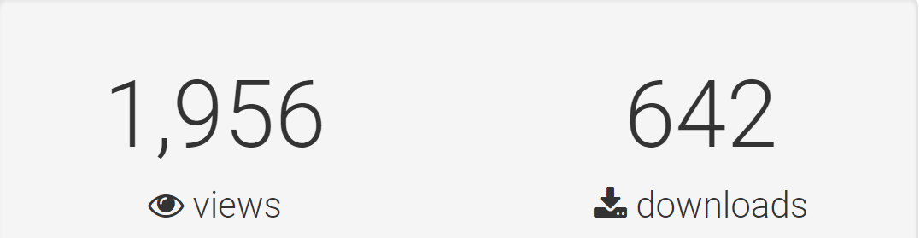
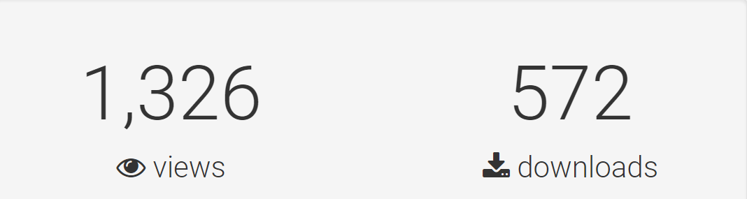
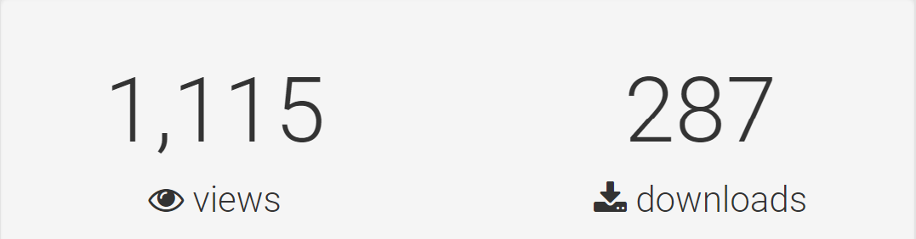
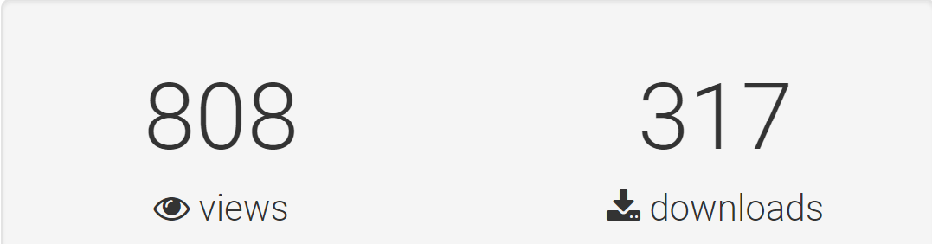

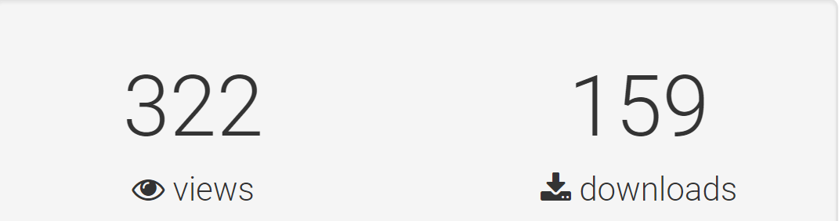
The footprint left by the StandICT.eu Fellows
1
2
3
4
Download
Download
Download
Download
5
5 Impact Reports published with the results from 258 ICT Standards Experts provide:
Thorough assessment of the impact in terms of target outcomes for EU priorities, gaps, and challenges;
Tangible evidence of the results attained by each of our funded fellows under OC1-OC5.
5,488 views and 1,964 downloads for the OC1-OC5 Reports!
Open Call #9 Coming soon next January!

Slide 7
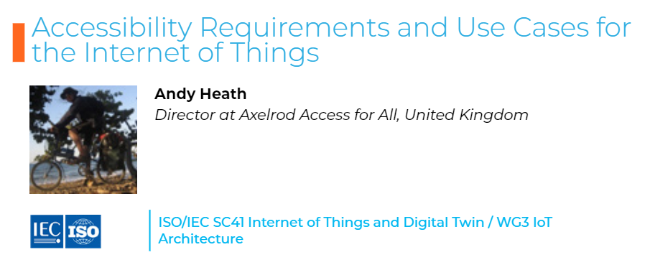
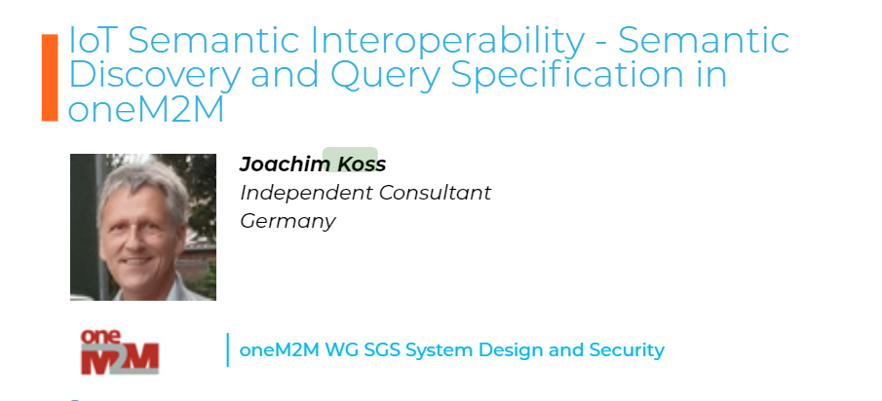

Tangible impact of StandICT.eu Fellows in the IoT domain
New Fellow
New Fellow
This activity led to the creation of an Ad Hoc group in “ISO/IEC SC35 User Interfaces” to better tackle the work with 9 participating and appointed experts.
This contribution will enable cross-domain and cross-vendor IoT semantic interoperability (oneM2M Standards: TS0001, TS0004, TS0034)

Slide 8

Online Event with the European Commission - 18th January 2023

Slide 9

Webinar Housekeeping
The event will be recorded and will be made available on StandICT.eu 2023 website within the next 24 hours (inclusive of the PPT presentations of each speaker).
Interactive chat is available by default.
We do encourage you though to enter any question in the dedicated Q/A box placed in the lower toolbar.
The speakers will be pleased to answer back your questions real-time.
You can follow the chat to be informed and receive link on the main StandICT.eu outputs and publications.

Slide 10
Silvana Muscella
Trust-IT CEO &
Coordinator of StandICT.eu 2023
s.muscella@trust-itservices.com

