Slide 1
The Digital Twin Consortium
Background and Contribution to EUOS
Claude Baudoin

Slide 2
The OMG Family
Object Management Group
OMG (the SDO, founded 1989)
Industry IoT Consortium (IIC)
Digital Twin Consortium (DTC)
Consortium for Information and Software Quality (CISQ)
BPM+ Health Initiative
Augmented Reality Enterprise Alliance (AREA)
● Unified Modeling Language
● Systems Modeling Language
● Business Process Model & Notation
● Unified Architecture Framework
● DDS: Data Distribution Service
● SENSR: Simplified Electronic Notation for Sensor Reporting
… and 230 more
● Industrial Internet Ref. Architecture (IIRA)
● II Security Framework
● II Communication Framework
● Security Maturity Model
● II Vocabulary
● Global Standards Strategy
● DT definition
● DT glossary
● Member Digital Marketplace
● Use Case Reference Library
● Value Innovation Platform
● Automated Source Code Metrics (fed to OMG’s SDO for standardization)
● Application of BPMN and related standards to clinical processes
● TBD (new kid on the block)

Slide 3
Some Digital Twin Use Cases
Advancing Real-Time Data Insights in Formula 1 Racing (aerodynamics)
McLaren Group / Dell
Optimizing Manufacturing Supply Chain
Michelin
Digital Twin for Water and Wastewater Management
Global Omnium / City of Valencia (and others)
Hybrid Digital Twin for EV High-Power Inverter
ANSYS and Bosch – watch www.brighttalk.com/webcast/18347/518172
See additional member stories at www.digitaltwinconsortium.org/success-stories.htm

Slide 4
DTC Event Calendar
December 7-9, 2021 - Quarterly Member Meeting, Long Beach, Calif.
January, 2022 - Harnessing the Power of Digital Twins - public information day (see DTC website for detais to come)
February, 2022 - Natural Resources Industry Roundtable - Green Day
March 8-10, 2022 - Q1 Member Meeting – at the Ferdinand Steinbeis Institut in Heilbronn, Germany (jointly with Industry IoT Consortium)
Interested in attending or presenting? Contact claude@omg.org for instructions
April, 2022 - Manufacturing Industry Roundtable
May 10-12, 2022 - IoT Solutions World Congress - Barcelona, Spain

Slide 5
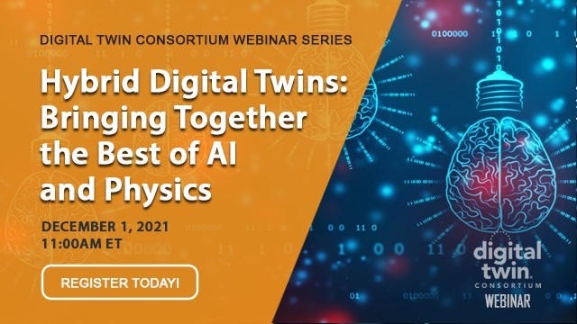
DTC Webinars
48 webinars from April 2020 to December 1, 2021
All recordings are publicly available at https://www.digitaltwinconsortium.org/webinars.htm

Slide 6
EUOS Technology Working Group (TWG) on Digital Twins
Work started end of August 2021
TWG co-chairs are Antonio Kung (Trialog) and Claude Baudoin (OMG)
Identified and solicited contributors and contributions
Organized the data -- collected 260 (!) document references
Actual standards
Guidelines
Papers
Next steps
Filter out the less relevant documents – too generic or not prescriptive enough
Add summaries when missing
Improve/complete the taxonomy of industry domains, subjects, types, etc.
Turn over to editor

